Slide 1
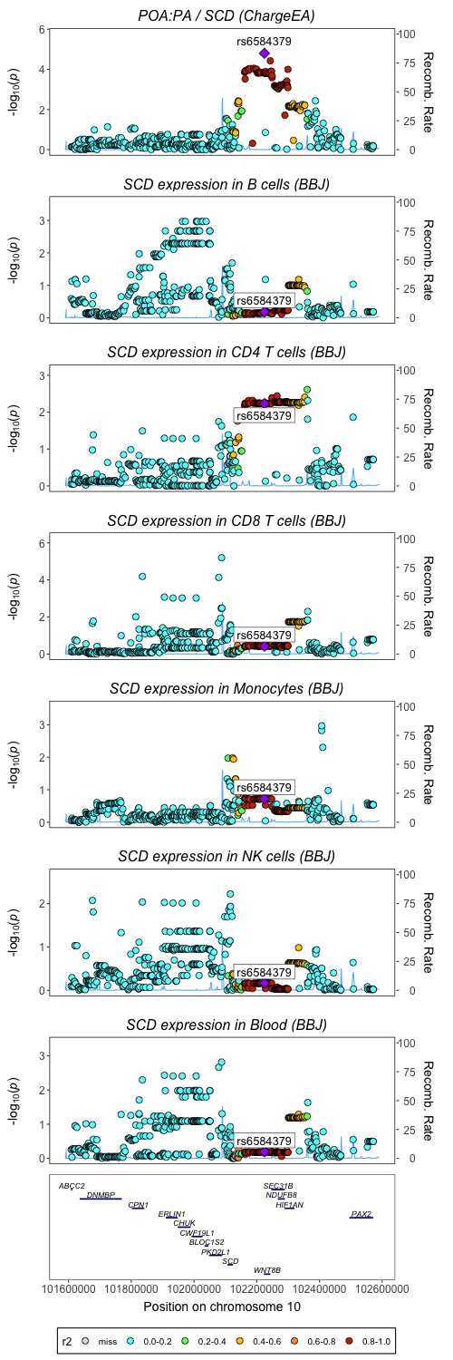
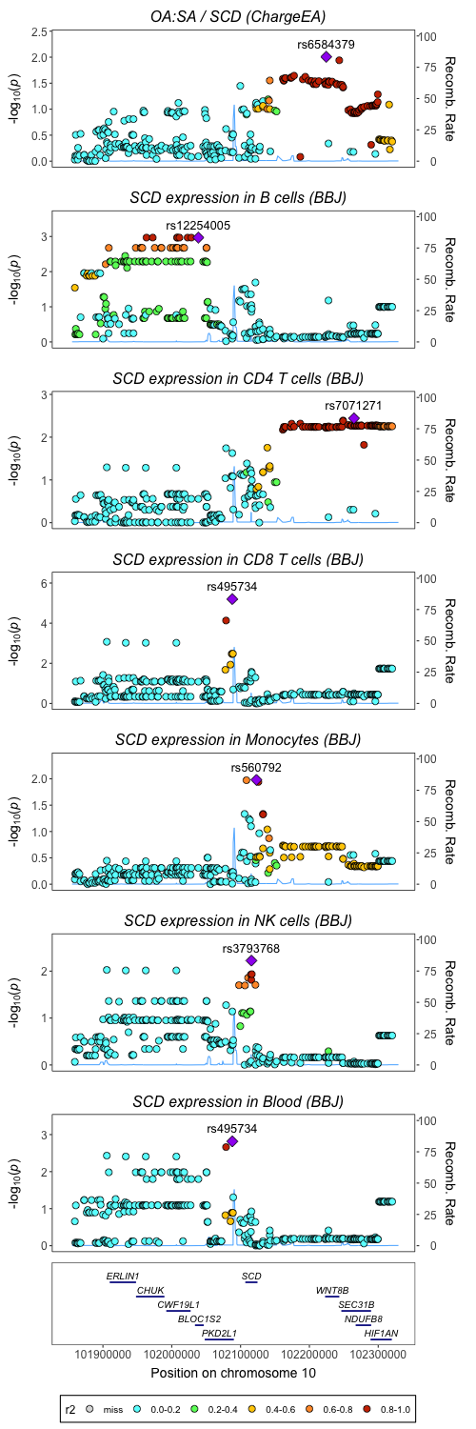
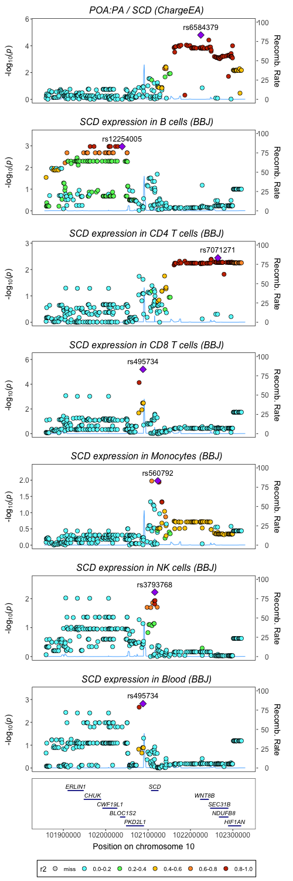
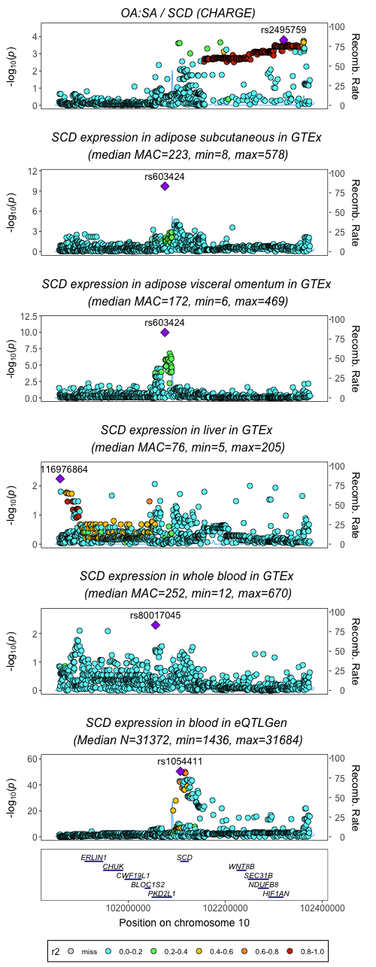
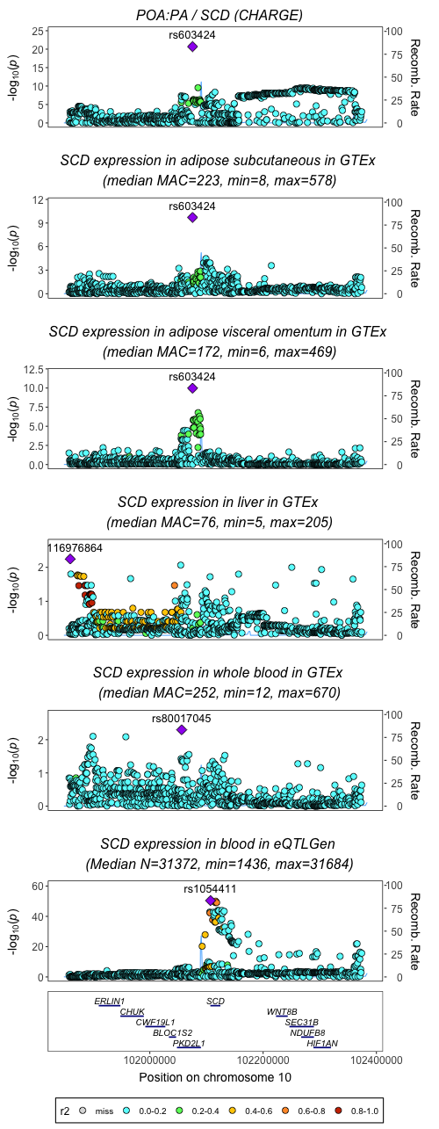
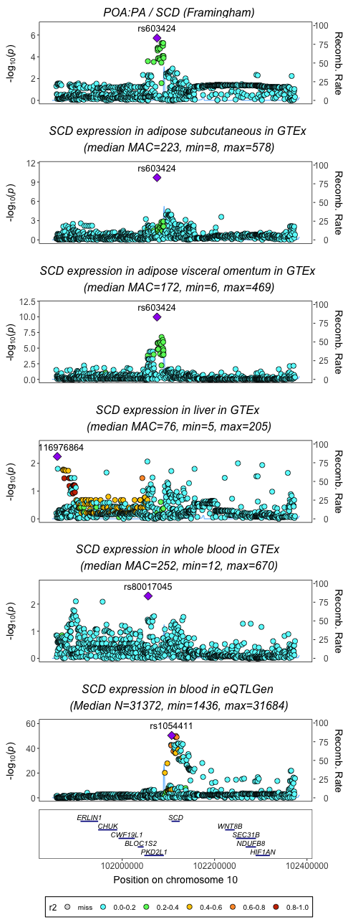
East Asians (eas ld ref panel)
Europeans (ukb ld ref panel)
Highlight rs6584379
OA:SA
POA:PA
CHARGE OA:SA
CHARGE POA:PA
Framingham POA:PA
Highlight rs603424

Slide 2
Exclude rs603424 and use eQTLs for SCD, SEC31B, HIF1AN and NDUFB8 (ukb ld ref panel)
SCD gene expression
Highlight rs3853519
SCD gene expression
Highlight rs683854
SCD gene expression
Highlight rs10509744
SEC31B gene expression
Highlight rs10509744
HIF1AN gene expression
Highlight rs10883508
HIF1AN gene expression
Highlight rs10509744
NDUFB8 gene expression
Highlight rs4244338
NDUFB8 gene expression
Highlight rs11190588
SCD gene expression

